Slide 1

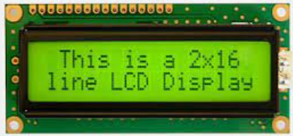

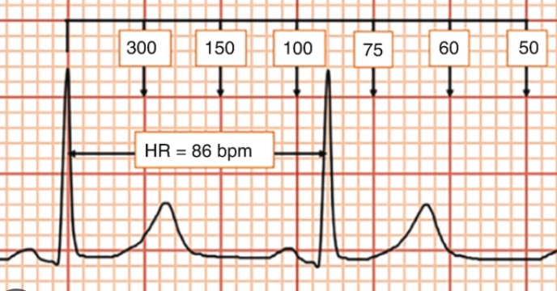

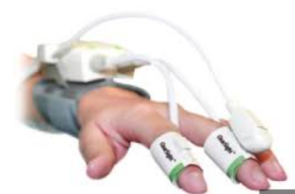
Patient Health Monitoring System
The main objective of this project is to design a remote healthcare monitoring system.
It’s comprised of 3 main parts.
Detection of patient’s condition using various sensors (Like – Heartbeat, Temperature, Body Movement etc.)
Display the Information over LCD. In case of any Emergency the ALARM and LED will Turn ON.
Using IOT the data will send to the cloud and Display over the Website with Patient Details.
Power Supply
Temperature
Humidity
Pin 2
Micro Controller
A0
10
11
ECG
Web
Application
Heartbeat Sensor
Buzzer
Patient Monitor System
ECG
Temperature
Movement
Patient Action
MQ135

Slide 2
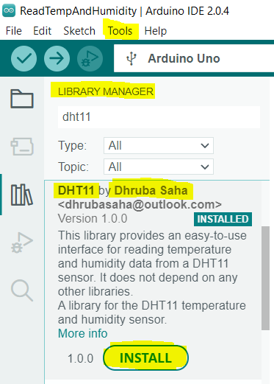
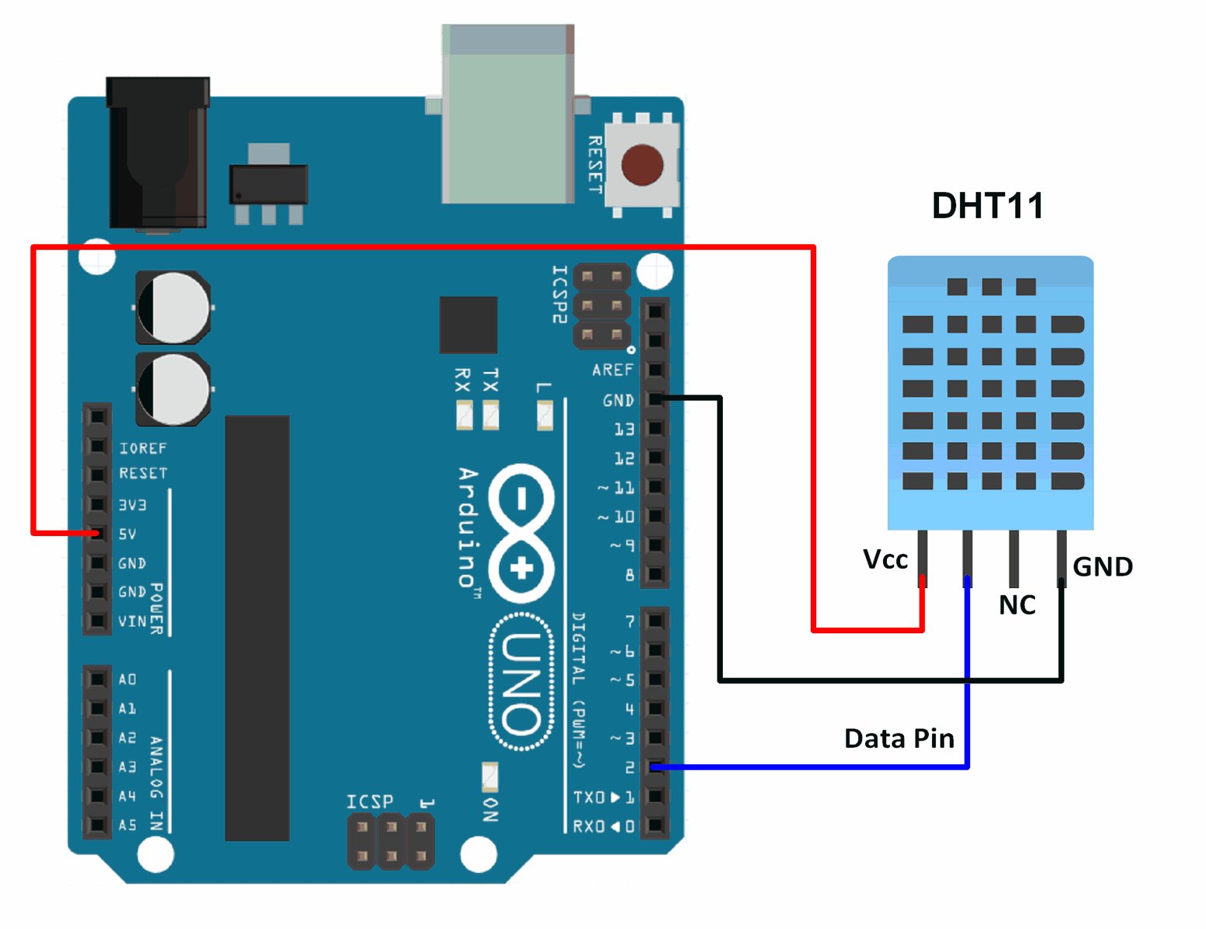
DHT11 - Humidity and Temperature
Humidity in percentage (20 to 90% RH)
Temperature in degree Celsius in the range of 0 to 50°C
4 pins – VCC, GND, DATA, NC
Examples > DHT11 > Read Temp & Humidity

Slide 3
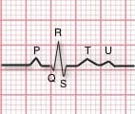
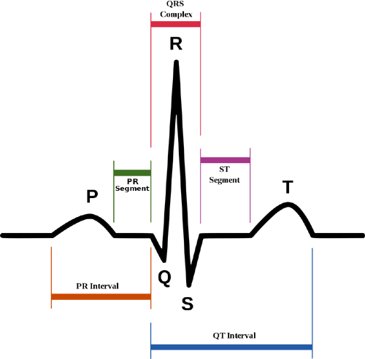
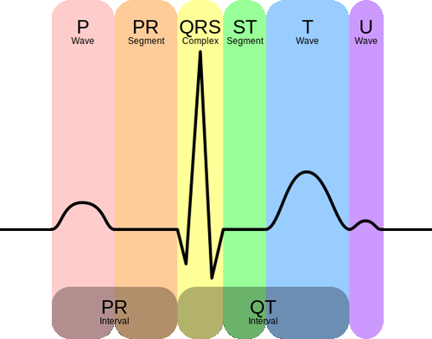
AD8232 ECG Sensor
The AD8232 is a neat little chip used to measure the electrical activity of the heart called Electrocardiogram/ECG.
ECGs are used to help diagnose heart arrhythmias, heart attacks, pacemaker function, and heart failure.
ECG can be analyzed by studying components of the waveform.
ECG signal can be seen on Arduino serial plotter or Processing IDE.
ECGs can be extremely noisy, the AD8232 Single Lead Heart Rate Monitor acts as an op-amp to help obtain a clear signal from the PR and QT Intervals easily.

Slide 4
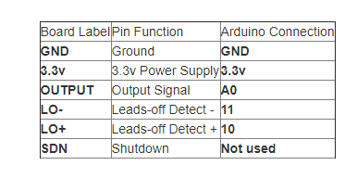
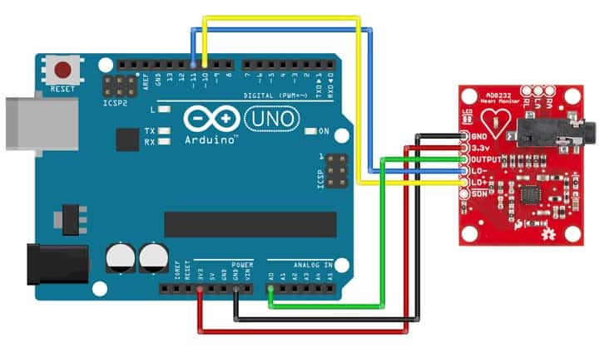
AD8232 with Arduino
GND
3.3v
OUTPUT – A0 Arduino
LO - 11 Digital Pin
LO + 10 Digital Pin
RA (Right Arm)
LA (Left Arm)
RL (Right Leg)
LED indicator light that will pulsate to the rhythm of a heartbeat.

Slide 5
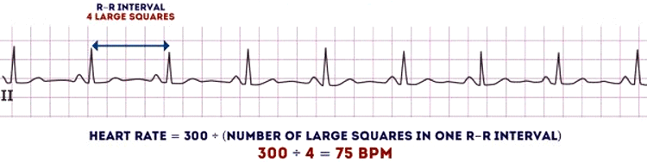

1

Slide 6
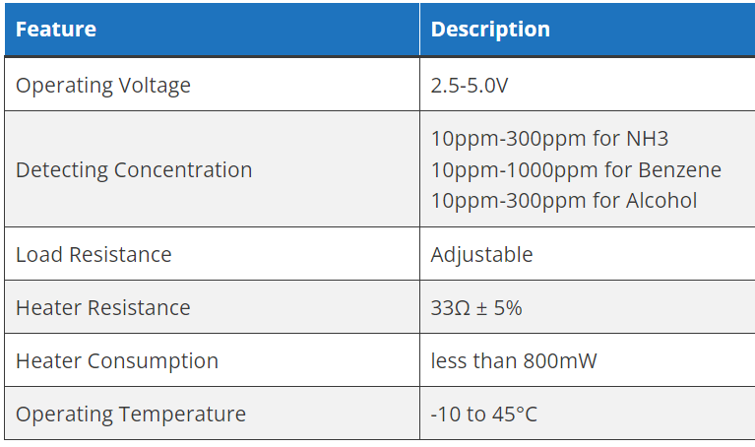
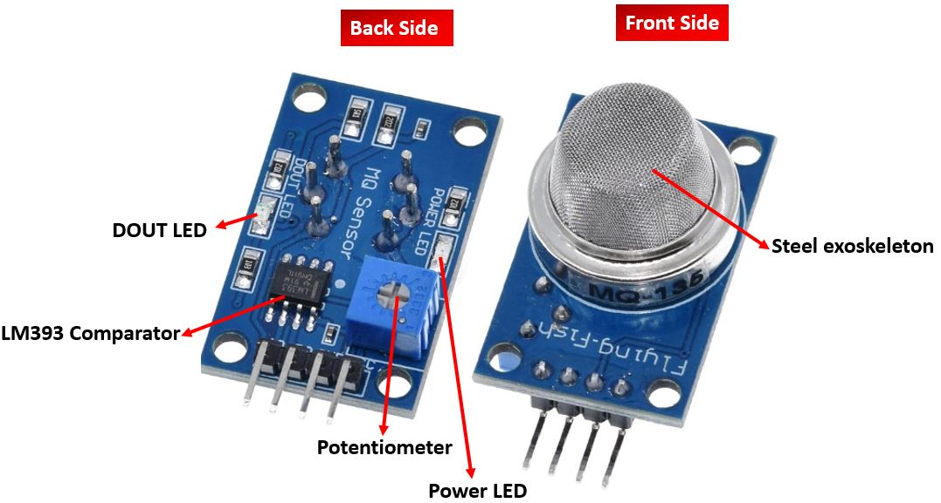
MQ-135
NH3, NOX, Alcohol, Benzene, Smoke, CO2 etc.
When no gas is present, digital output is 1 and analog output gives 1023 max value. When gas is present, digital output is 0 and analog output is much less than 1023.

Slide 7
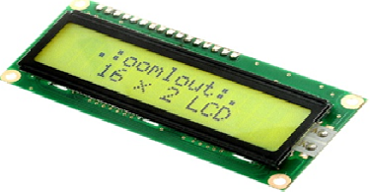
16x2 LCD
The term LCD stands for liquid crystal display. It is one kind of electronic display module used in an extensive range of applications like various circuits & devices like mobile phones, calculators, computers, TV sets, etc.
These displays are mainly preferred for multi-segment light-emitting diodes and seven segments. The main benefits of using this module are inexpensive; simply programmable, animations, and there are no limitations for displaying custom characters, special and even animations, etc.

Slide 8
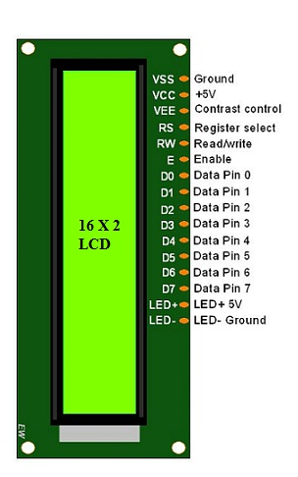
Pinout of 16x2 LCD
A register select (RS) pin that controls where in the LCD's memory you're writing data to. You can select either the data register, which holds what goes on the screen, or an instruction register, which is where the LCD's controller looks for instructions on what to do next.
A Read/Write (R/W) pin that selects reading mode or writing mode
An Enable pin that enables writing to the registers
8 data pins (D0 -D7). The states of these pins (high or low) are the bits that you're writing to a register when you write, or the values you're reading when you read.
There's also a display contrast pin (Vo), power supply pins (+5V and GND) and LED Backlight (Bklt+ and BKlt-) pins that you can use to power the LCD, control the display contrast, and turn on and off the LED backlight, respectively.

Slide 9
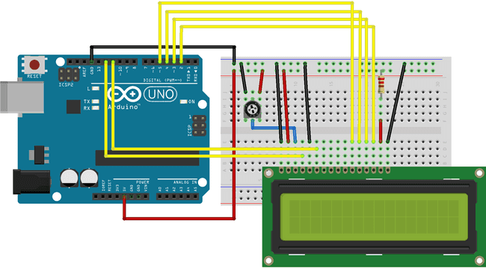
LCD connect with Arduino
LCD RS pin to digital pin 12
LCD Enable pin to digital pin 11
LCD D4 pin to digital pin 5
LCD D5 pin to digital pin 4
LCD D6 pin to digital pin 3
LCD D7 pin to digital pin 2
LCD R/W pin to GND
LCD VSS pin to GND
LCD VCC pin to 5V
LCD LED+ to 5V through a 220 ohm resistor
LCD LED- to GND
Additionally, wire a 10k potentiometer to +5V and GND, with it's wiper (output) to LCD screens VO pin (pin3).

Slide 10
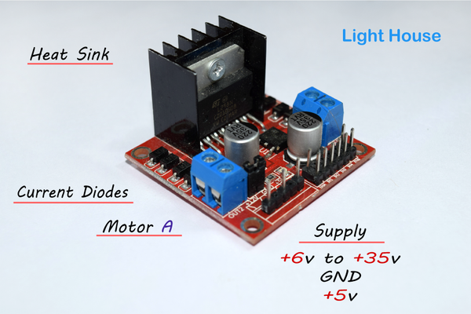
Interface an L298N Dual H-Bridge Motor Driver module with an NodeMCU.
L298N Dual H-Bridge Motor Controller Module.
Can drive a current in either polarity and be controlled by Pulse Width Modulation (PWM).
Specifications:
Double H bridge Driver Chip: L298N
Logical voltage: 5V
Drive voltage: 5V-35V
Logical current: 0-36mA
Drive current: 2A (MAX single bridge)
Max power: 25W

